Slide 1



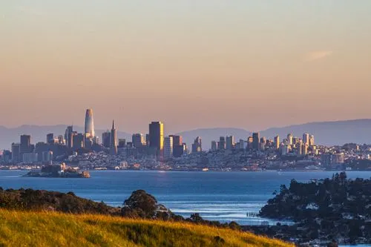

Business Trip Proposal: Exploring Innovation in Silicon Valley.
A Journey to Enhance Our Work Performance.
Manuel Marin Sanchez.
08/09/2026
Business English II

Slide 2
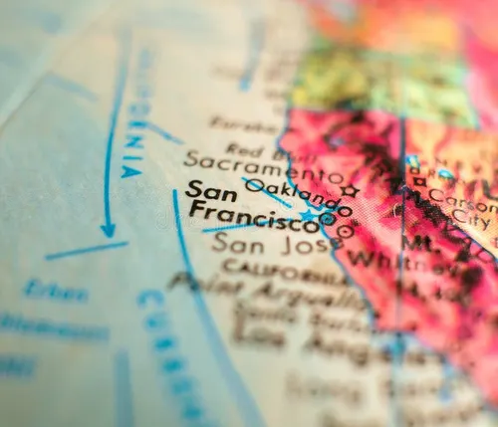
Title: Why This Business Trip?
In today’s competitive software industry, staying ahead requires continuous learning and exposure to global trends. This proposal presents a business trip to San Francisco, California, specifically to visit Silicon Valley – the world’s leading technology hub. This trip will allow us to attend conferences, visit innovative companies, and network with industry experts, ultimately improving our work performance.

Slide 3

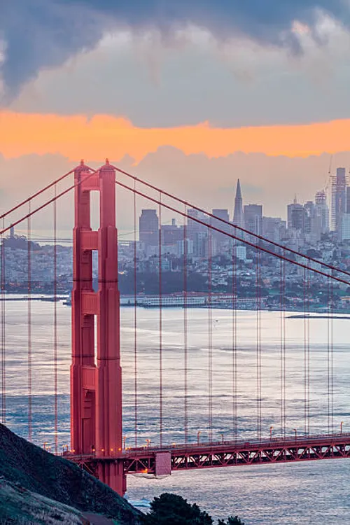
TITLE: ABOUT SAN FRANCISCO
San Francisco is a city located on the West Coast of the United States. It is known for its iconic Golden Gate Bridge, diverse culture, and vibrant technology scene. The city is home to hundreds of tech startups and global corporations such as Google, Apple, and Facebook. Its mild climate and scenic beauty make it an attractive destination for business and leisure.

Slide 4

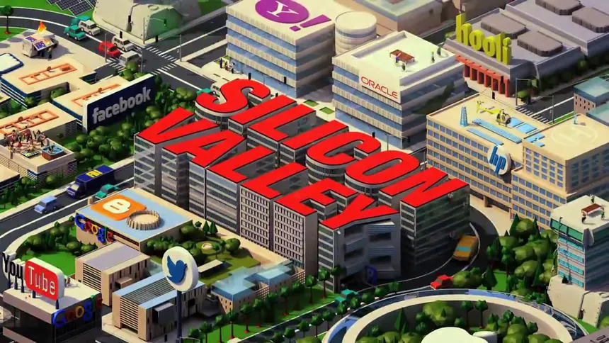

TITLE: THE HEART OF INNOVATION
Silicon Valley is the epicenter of technological innovation. It hosts the headquarters of major tech companies and thousands of startups. Visiting this area will provide us with:
  Exposure to cutting-edge technologies (AI, cloud computing, cybersecurity).
  Insights into agile development and modern software engineering practices.
  Opportunities to learn from success stories and failures of renowned companies.

Slide 5

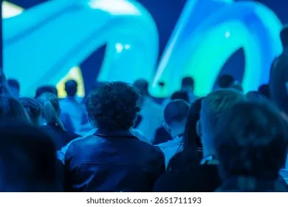
TITLE: PROPOSED ACTIVITIES
During this 5-day trip, we plan to:
  Attend the TechCrunch Disrupt Conference – to learn about emerging trends.
  Visit Google’s Campus – to understand their work culture and innovation processes.
  Network with local entrepreneurs – to explore potential partnerships.
  Take a workshop on Design Thinking – to apply human-centered design in our projects.

Slide 6
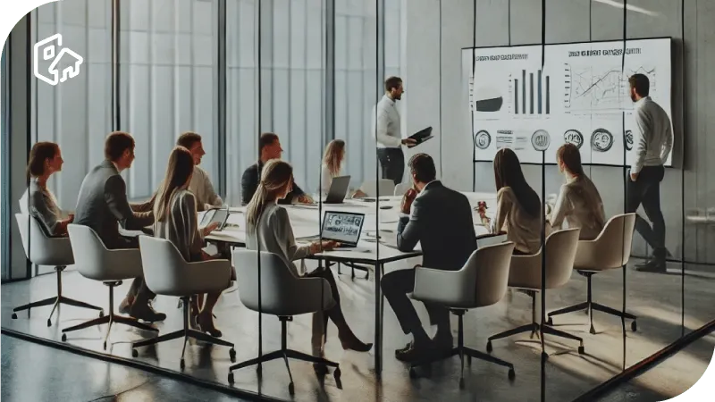
HOW THIS TRIP IMPROVES OUR PERFORMANCE
This trip will directly benefit our team by:
  Enhancing our technical knowledge by exposing us to new tools and methodologies.
  Improving our problem-solving skills by learning how global companies tackle challenges.
  Boosting creativity and innovation – by seeing how other teams approach product development.
  Strengthening our professional network – opening doors for future collaborations.

Slide 7

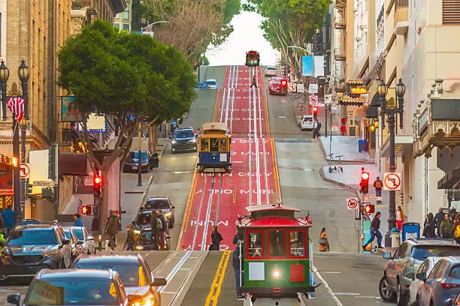
BEYOND WORK: CULTURAL ENRICHMENT
Traveling also enriches us personally. In San Francisco, we can:
  Experience cultural diversity through its neighborhoods (Chinatown, Little Italy).
  Visit museums and historical landmarks like Alcatraz Island.
  Practice English in real-world business and social settings.
  Build stronger team relationships through shared experiences.

Slide 8
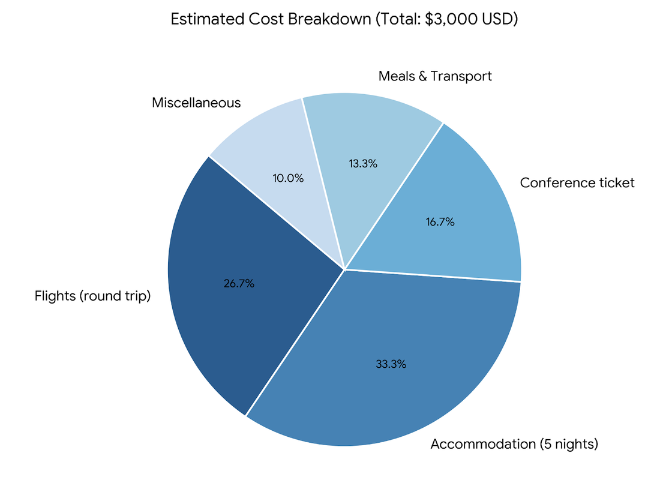
TRIP COST OVERVIEW
Concept Estimated Cost (USD)
Flights (round trip) $800
Accommodation (5 nights) $1,000
Conference ticket $500
Meals & Transport $400
Miscellaneous $300
Total $3,000

Slide 9


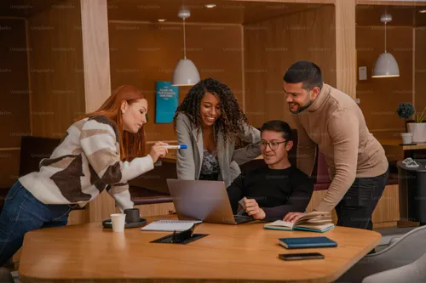
WHAT WE WILL ACHIEVE
After this trip, we expect to:
Implement at least one new conference practice in our workflow.
Share key learnings with the team in a presentation.
Explore potential tools that can optimize our development processes.
Strengthen our company’s reputation by connecting with international peers.

Slide 10
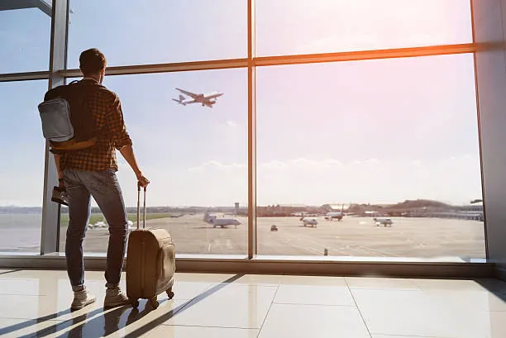
LET’S MAKE IT HAPPEN!
Investing in this business trip is investing in our future. The knowledge, connections, and inspiration we will gain are invaluable. I strongly recommend approving this trip to position our company at the forefront of innovation.
Thank you for your consideration. I look forward to your positive response.

